Slide 1
24
7
30
Topic: Rates
Date:
EQ – How can a rate help me exchange money overseas?
A rate is a way of comparing two amounts of different types of quantities. They usually involve the word per which means ‘for each’
Some examples of rates are:
What is a rate?
• Mary earns $15 an hour working at the supermarket.
• Flour costs $4.50 a kilogram.
• The Smith household uses 500 litres of water per day over a period of 3 months.
• A swimmer does an average 30 laps an hour in training sessions.
Notes:
Where will I use rates:
In Science: Pressure, Density, Speed, Acceleration, Rotation, density
In business: Exchange rates, Interest rates, taxation rates, postal charges

Slide 2
24
7
30
Topic: Rates
Date:
EQ – How can a rate help me exchange money overseas?
• Mary earns $15 an hour working at the supermarket.
What is a rate?
• Mary earns $45 an in 3 hours working at the supermarket.
To work out the rate we have to divide both the $ and the hours by 3, so that we can find the $ for 1 hour.
45/3 = 15
Mary will earn $15 in one hour, so that is $15/hr
Notes:
Where will I use rates:
In Science: Pressure, Density, Speed, Acceleration, Rotation, density
In business: Exchange rates, Interest rates, taxation rates, postal charges

Slide 3
24
7
30
Topic: Rates
Date:
EQ – How can a rate help me exchange money overseas?
Speed is one of the most familiar rates. There are three quantities associated with questions that involve constant speed.
Finding the distance given a fixed speed: A car travels at a constant speed of 60km/h.
  The car travels 60km in 1 hour.
  The car travels 120km in 2 hours
  The car travels 60t kilometres in t hours.
How is speed is a rate?

Slide 4
24
7
30
Topic: Rates
Date:
EQ – How can a rate help me exchange money overseas?
  The car travels 60km in 1 hour.
  The car travels 120km in 2 hours
  The car travels 60t kilometres in t hours.
Finding the speed given a fixed distance : A car travels at a constant speed for 100km.
  If the car takes 1 hour to travel the 100km, then the speed is 100km/h.
  If the car takes 2 hours to travel the 100km, then the speed is 100/2 = 50km/h.
  If the car takes t hours to travel the 100 km, then the constant speed is 100/t km/h.
How is speed a rate?

Slide 5
24
7
30
Topic: Rates
Date:
EQ – How can a rate help me exchange money overseas?
  If the car takes 1 hour to travel the 100km, then the speed is 100km/h.
  If the car takes 2 hours to travel the 100km, then the speed is 100/2 = 50km/h.
  If the car takes t hours to travel the 100 km, then the constant speed is 100/t km/h.
Finding the time given a fixed distance: A car travels 100km.
  A car travels a distance of 100km at 100km/h. It takes 1 hour.
  A car travels a distance of 100km at 50km/h. It takes 2 hours.
  A car travels a distance of 100km at v km/h. It takes 100 v hours
How is speed a rate?

Slide 6
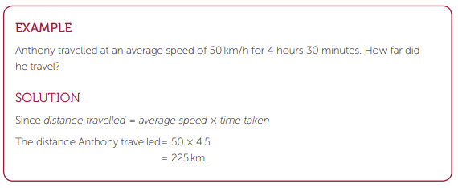
24
7
30
Topic: Rates
Date:
EQ – How can a rate help me exchange money overseas?
How is speed a rate?

Slide 7
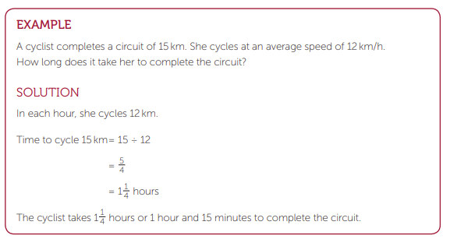
24
7
30
Topic: Rates
Date:
EQ – How can a rate help me exchange money overseas?
How is speed a rate?

Slide 8
24
7
30
Topic: Rates
Date:
EQ – How can a rate help me exchange money overseas?
How can I exchange money?
Do Dwyer Ex. 4.4 Page 53
Notes:
Get the students to list on the board all of the countries they have been to
Pick one and then look up the conversion for it
Get a student to pick a thing they would like to buy, e.g. hoodie, sneakers etc.
Convert this from Australian $ to blah blah

